Slide 1
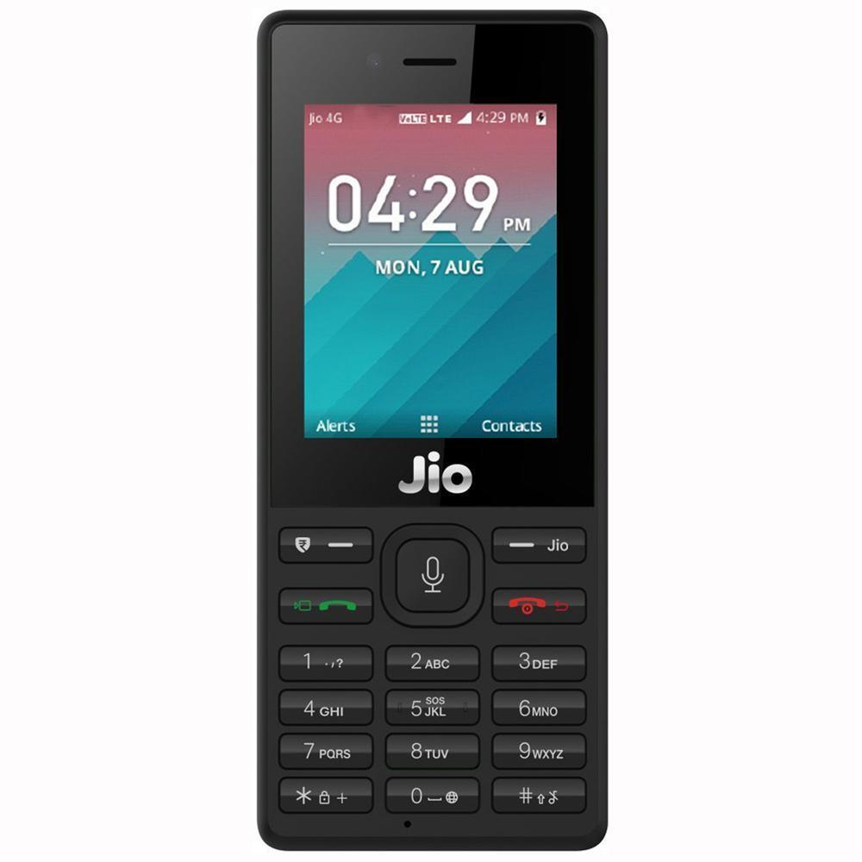
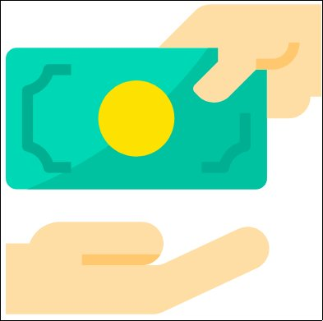
Pocket Money
Int Elligence - IIT Kanpur
Umang Malik
Vaibhav Thakkar
Aryan Choudhary
Apurva Nandan

Slide 2
Accountant in your pocket.

Slide 3
Target Audience -
Significant portion of Jio users belong to Lower and lower middle-class of the society.

Slide 4
Target Audience -
Significant portion of Jio users belong to Lower and lower middle class of the society, who are particular about their income/expenditure and care about every transaction they make.

Slide 5
What does it do ?

Slide 6
What does it do ?
It keeps a record of your all transactions.

Slide 7
What does it do ?
It keeps a record of your all transactions.
It helps in the easy splitting of bills.

Slide 8
What does it do ?
It keeps a record of your all transactions.
It helps in the easy splitting of bills.
Keep record money lent to and from others

Slide 9
Expenditure records -

Slide 10
Expenditure records -
Our app also includes expenditure records for daily expenses categorised into common verticals like shopping, healthcare, food etc.

Slide 11
Expenditure records -
Our app also includes expenditure records for daily expenses categorised into common verticals like shopping, healthcare, food etc.
This helps people particular about their daily expenses to track down their daily expenses digitally on the go.

Slide 12
How we built it?
It was built using nodejs/express, HTML5, and JavaScript.

Slide 13
How we built it?
It was built using nodejs/express, HTML5, and JavaScript.
Can be easily packaged into feature phones.

Slide 14

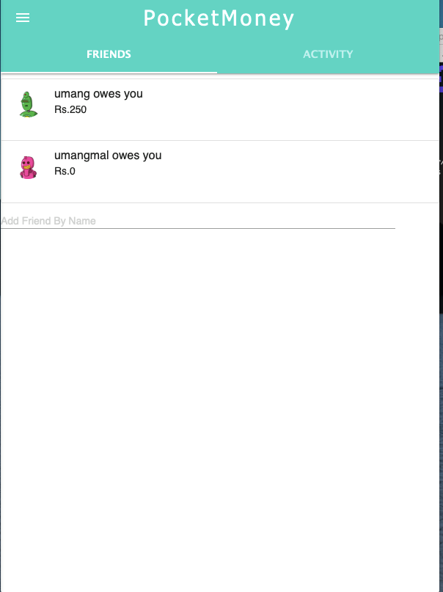
Screenshots

Slide 15
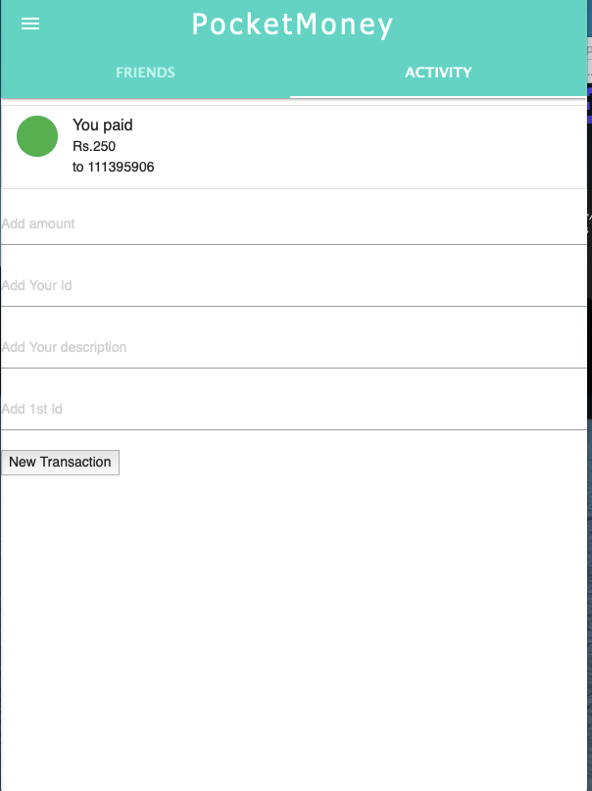
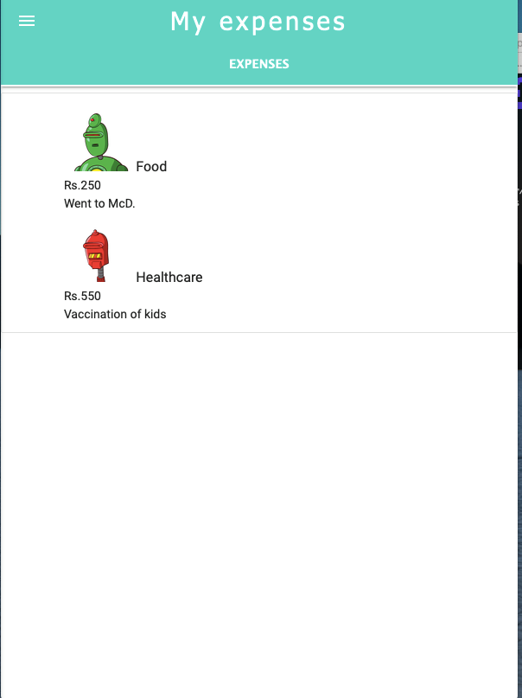
Screenshots

Slide 16
Things we are proud of-
Lots of scalable API’s have been developed which can be directly used for customization like-
Group sharing
Money settlement
Expense analysis

Slide 17
What’s next for Pocket Money?

Slide 18
What’s next for Pocket Money?
It can be integrated with JioMoney, NFC and other money sharing apps.

Slide 19
What’s next for Pocket Money?
It can be integrated with JioMoney, NFC and other money sharing apps.
It can be integrated with smart watches as well (expense tracking).

Slide 20
What’s next for Pocket Money?
It can be integrated with JioMoney, NFC and other money sharing apps.
It can be integrated with smart watches as well.
It can be extended for groups as well.

Slide 21
Thank You

